Slide 1

Optical charting of brain-wide activation maps neuron by neuron
L. Silvestri, N. Rudinskiy, M. Paciscopi, M.C. Müllenbroich, I. Costantini, L. Sacconi, P. Frasconi, B.T. Hyman & F.S. Pavone
Focus on Microscopy 2015
Göttingen, Germany, April 1st, 2015

Slide 2

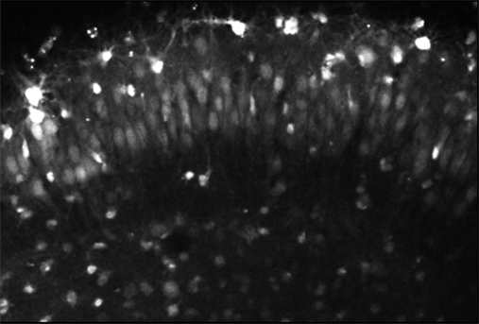
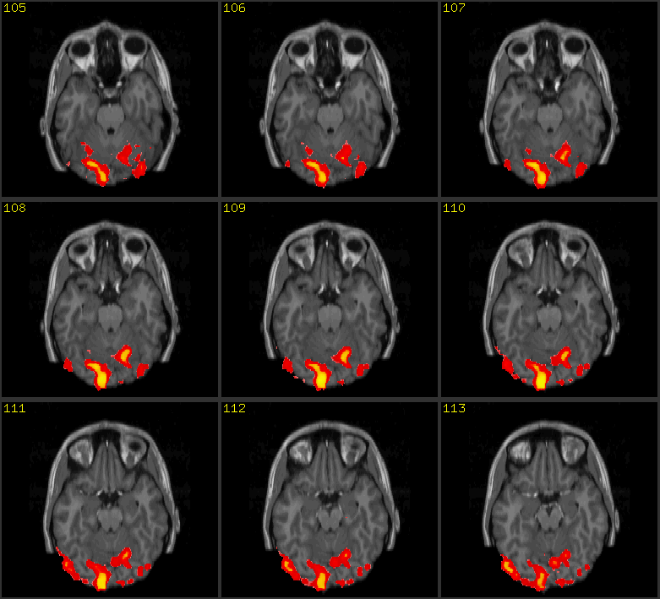
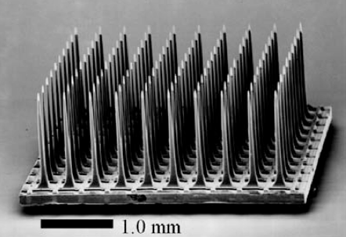
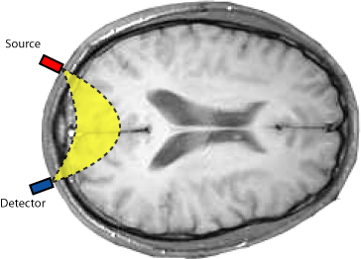
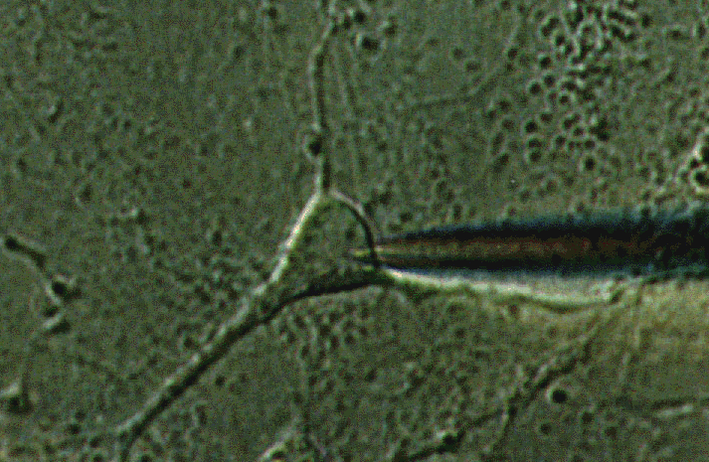
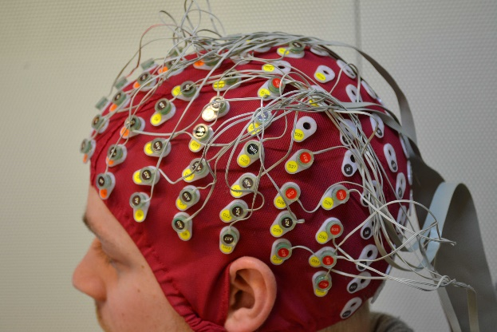
Imaging brain activity
Large area (even whole brain)
Low resolution
Optical calcium or VSD imaging
fMRI
MEA
Patch
clamp
fNIR
EEG
High resolution (even cellular)
Small area
Focus on Microscopy 2015 – Göttingen, Germany, April 1st, 2015

Slide 3

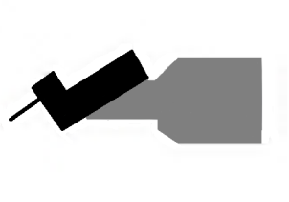
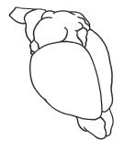
Imaging brain activation
Current in vivo imaging methods cannot afford cellular resolution in the whole brain, at least in mammals. On the other hand, ex vivo technologies, such as serial two-photon or light sheet microscopy, can produce whole-brain images with micron resolution.
The idea is to use a genetic strategy to label active neurons, and then image the whole fixed brain.
Microtome
Transgenic mouse expressing a (destabilized) fluorescent protein under the promoter of an immediate early gene (like Arc or c-fos)
Whole brain high resolution imaging
Focus on Microscopy 2015 – Göttingen, Germany, April 1st, 2015

Slide 4
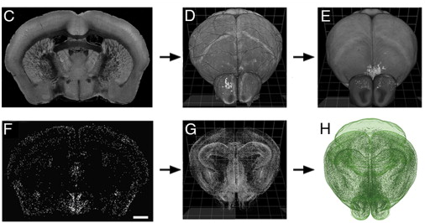
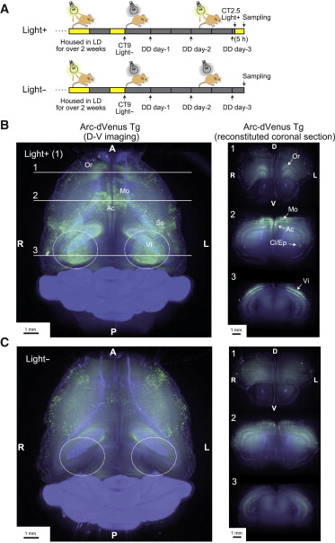
Imaging brain activation
Kim et al., Cell Rep. 2015
Serial two-photon imaging with automatic cell localization
Only 4% of the volume is actually imaged (2 µm thin optical sections every 50 µm)
Susaki et al., Cell 2014
Light sheet full volumetric imaging
No quantitative analysis
Focus on Microscopy 2015 – Göttingen, Germany, April 1st, 2015

Slide 5
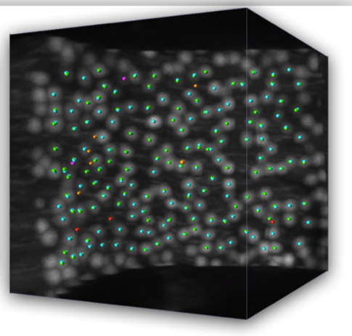
Imaging brain activation
Arc-dVenus transgenic mouse
Light sheet microscopy
Automatic cell localization
Focus on Microscopy 2015 – Göttingen, Germany, April 1st, 2015

Slide 6
Light sheet microscopy
Confocal slit detection coupled with digitally scanned light sheet excitation allows removing out-of-focus and scattered light, allowing a 100% contrast increase in cleared specimens.
GM galvo mirror, SL scanning lens, Obj microscope objective, TL tube lens, L lens, FF fluorescence filter, EM-CCD electron-multiplying charge-coupled-device.
Silvestri et al., Opt. Exp. 2012
Focus on Microscopy 2015 – Göttingen, Germany, April 1st, 2015

Slide 7
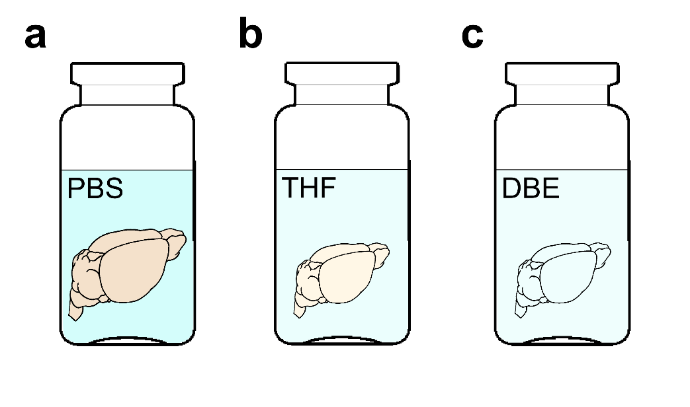
Chemical clearing of the brain
PBS
Mouse are transcardially perfused with phosphate-buffered saline (PBS) solution followed by 4% paraformaldehyde (PFA). Afterwards, brains are removed from the skull, postfixed overnight in PFA and stored in PBS. Samples are then dehydrated in a graded series of tetrahydrofuran (THF) in PBS and finally immersed in dibenzyl ether (DBE), an index-matching organic solvent.
DBE
Becker et al., PLoS ONE 2012
Silvestri et al., JoVE 2013
Focus on Microscopy 2015 – Göttingen, Germany, April 1st, 2015

Slide 8
Automatic 3D cell localization challenges
Very large samples (cm-sized)
Large variability of contrast in different areas
TB-sized datasets
Naïve methods (as thresholding or clustering) are poorly effective as usually depend on sensitive parameters
Advanced methods usually require the calculation of multiple features per each image voxel, leading to a data multiplication which is not manageable with large datasets
Focus on Microscopy 2015 – Göttingen, Germany, April 1st, 2015

Slide 9
Semantic deconvolution
Semantic deconvolution uses a supervised neural network, to enhance selected features of the image reducing the intensity of other structures.
Original image
Deconvolved image
Neural network
This method creates a more uniform image where significant structures (hence the name semantic) are well visible.
In the deconvolved image, easy low-cost localization algorithms (e.g. clustering) can achieve very good performances.
Manual soma localization
Supervision
Ideal image
Only on a small subset
Frasconi et al., Bioinformatics 2014
Focus on Microscopy 2015 – Göttingen, Germany, April 1st, 2015

Slide 10
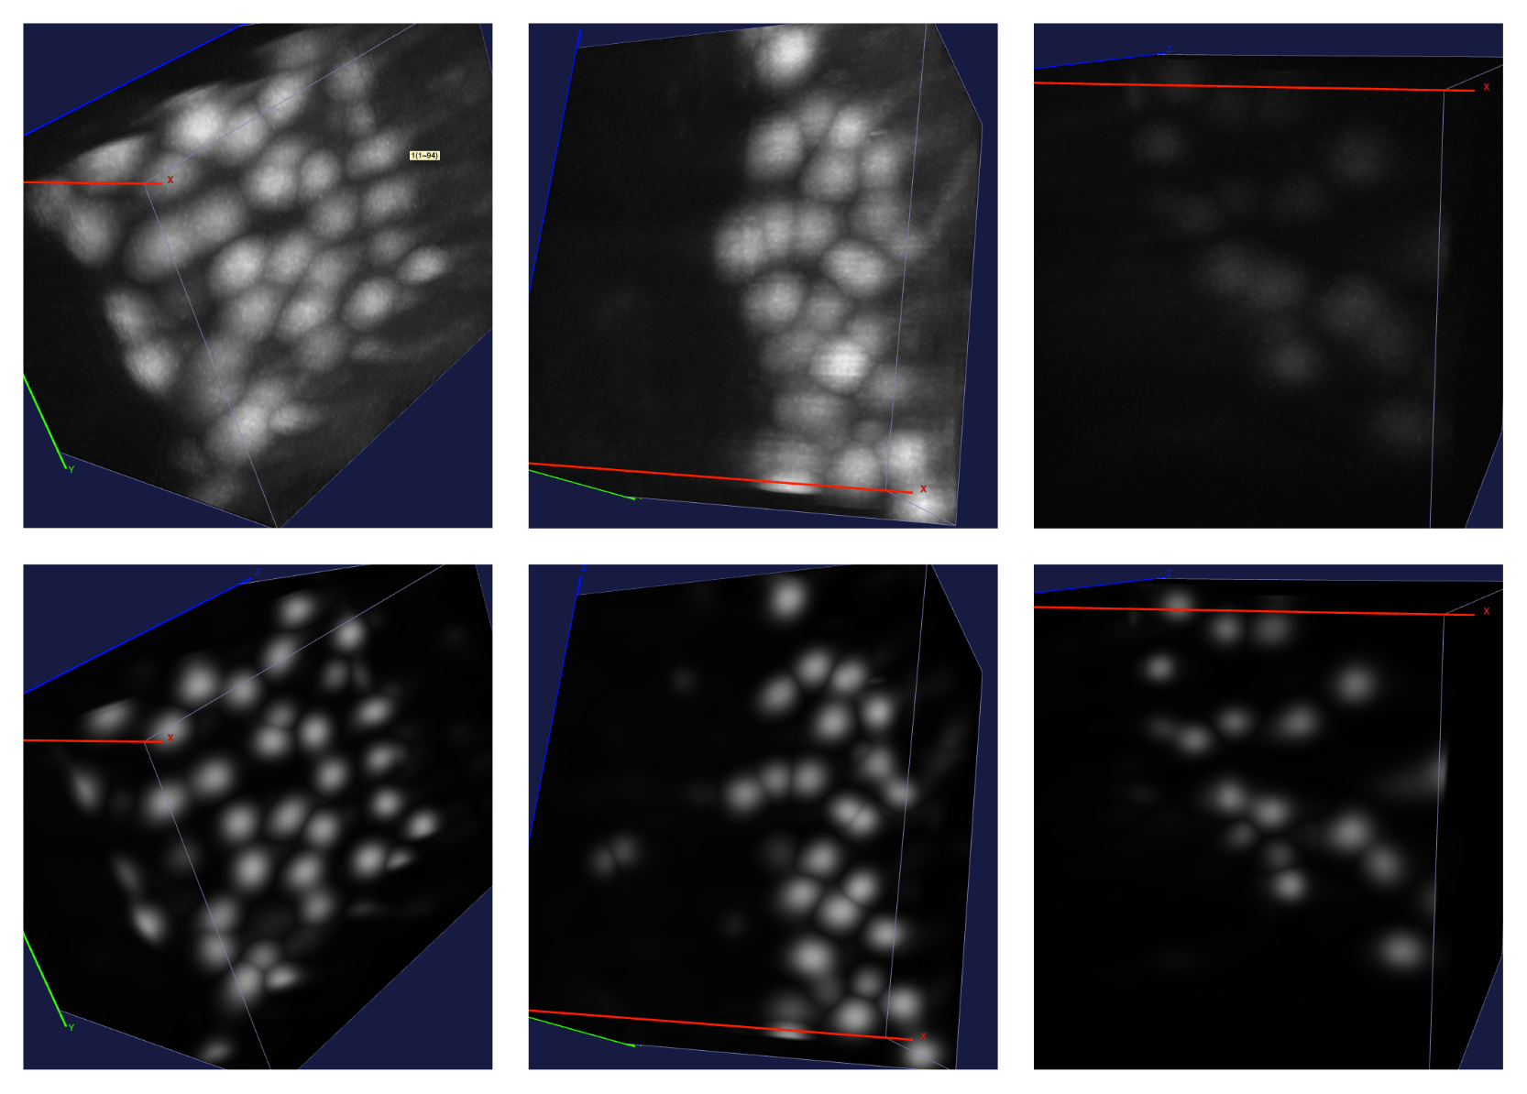
Semantic deconvolution
Original
images
Deconvolved
images
Frasconi et al., Bioinformatics 2014
Focus on Microscopy 2015 – Göttingen, Germany, April 1st, 2015

Slide 11
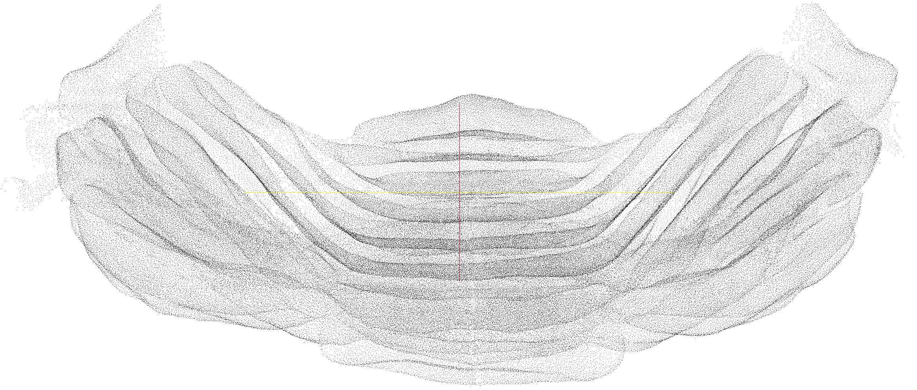
Semantic deconvolution
224’222 Purkinje cells automatically localized in the cerebellum of an L7-GFP mouse. Precision (true positives/all localized cells) is 95%, recall (true positives/all real cells) 97%
~ 1 day of computation on a 16-cores workstation to analyze 120 Gvoxels
Frasconi et al., Bioinformatics 2014
Focus on Microscopy 2015 – Göttingen, Germany, April 1st, 2015

Slide 12
Multi-view imaging
In large cleared specimens, residual scattering inside the tissue reduce the useful amount of photons that can be collected when going deep either in excitation or detection
0°
90°
Detection objective
180°
270°
Image degradation
Scale bar 1 mm
Multi-view imaging can mitigate this problem, as areas which are badly imaged in one view become nicer in another view.
Image degradation
Focus on Microscopy 2015 – Göttingen, Germany, April 1st, 2015

Slide 13
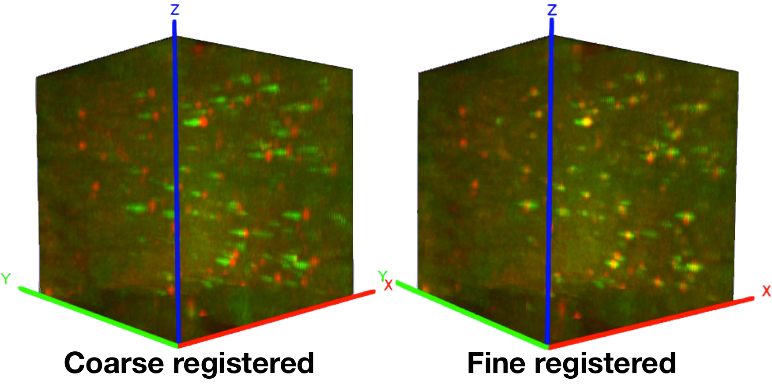
Multi-view registration
0°
The 4 views are first coarsely aligned using manually placed landmarks (about 30-40 per view).
Volumes are then substacked to allow finer local registration based on entropy maximization.
90°
180°
270°
Coarse registration
Focus on Microscopy 2015 – Göttingen, Germany, April 1st, 2015

Slide 14
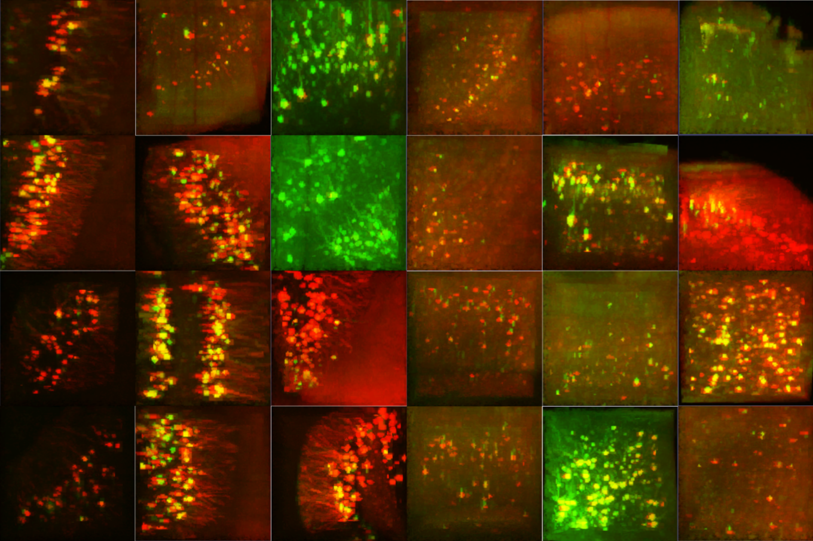
Multi-view registration
Substacking is also useful to locally estimate background tresholds.
Here on the right an example of the high variability of image quality between different views (false red/green colors) in different regions of the specimen.
Focus on Microscopy 2015 – Göttingen, Germany, April 1st, 2015

Slide 15
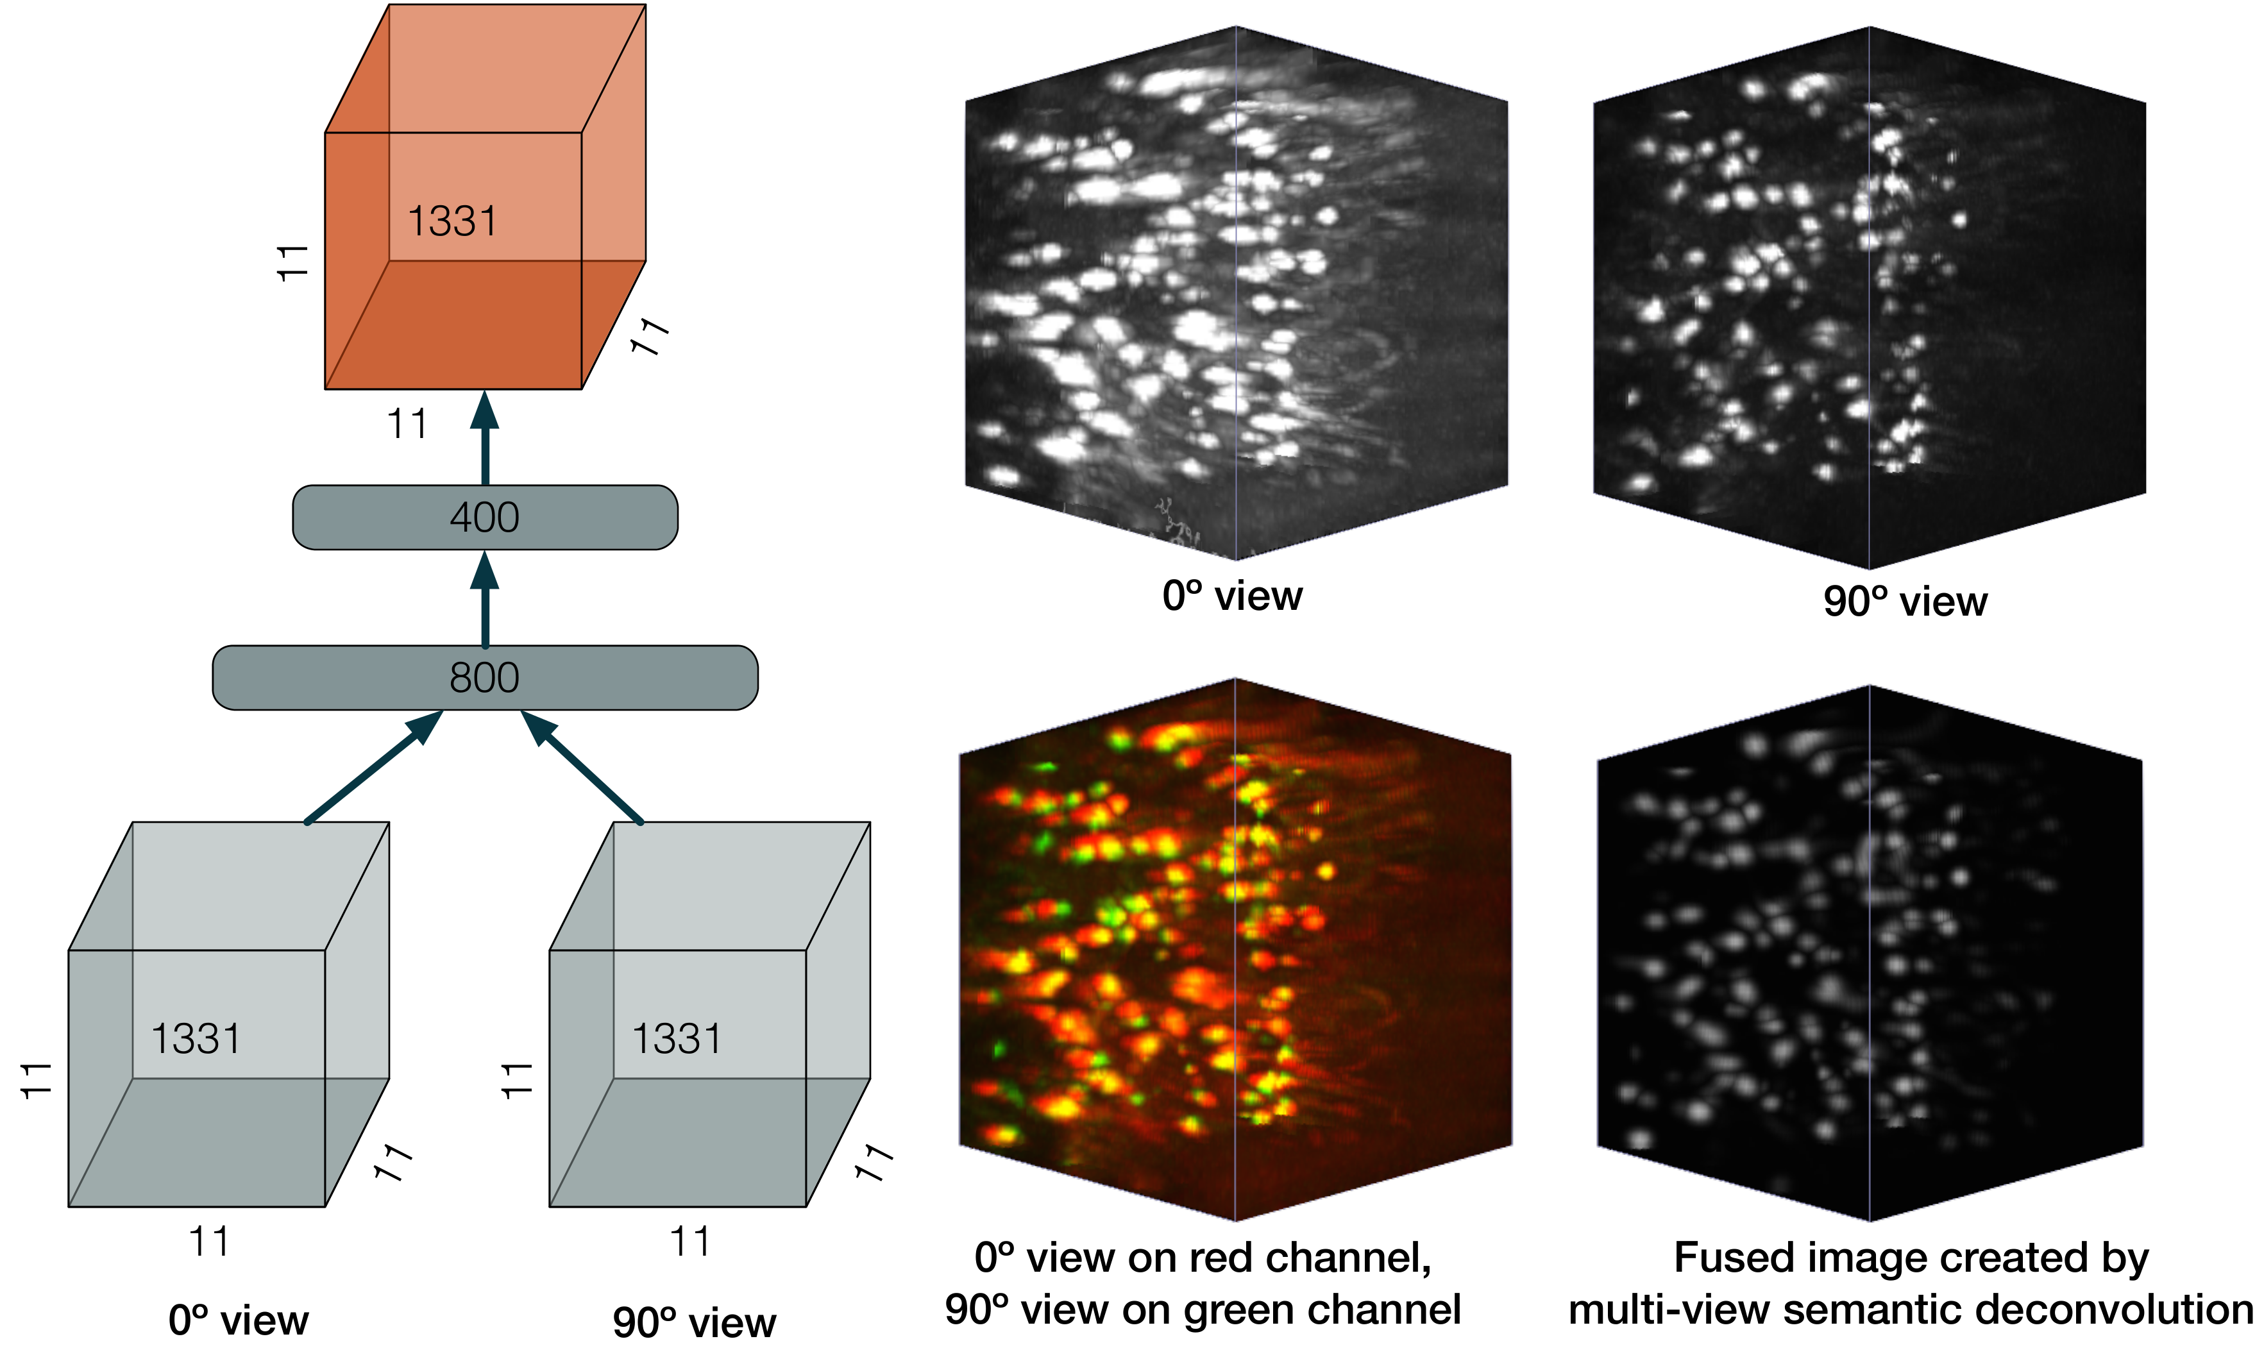
Multi-view semantic deconvolution and fusion
Semantic deconvolution is applied to couple of substacks from adjacent views. The artifical neural network both enhance somata shape and fuses different images. Ground truth sets, used either for training the network or for testing it, are derived by merging manual annotations from two views.
The fusion process helps to homogenize the contrast in the whole brain, as well as to amend resolution anisotropy
Focus on Microscopy 2015 – Göttingen, Germany, April 1st, 2015

Slide 16
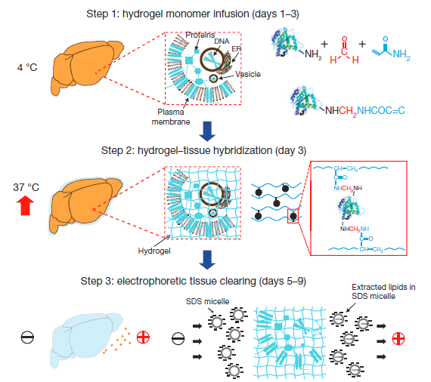
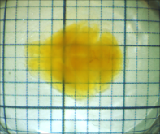
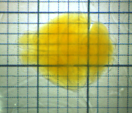
Outlook: improved clearing and microscopy
CLARITY, a new method for tissue transformation and clearing, allows obtaining very transparent brains in an aqueous environment, better preserving protein fluorescence.
FocusClearTM
(original CLARITY protocol)
TDE 63%
We recently found a valid alternative to FocusClear for refractive index homogeneization.
Chung et al., Nature 2013
Costantini et al., Sci. Rep. accepted
Focus on Microscopy 2015 – Göttingen, Germany, April 1st, 2015

Slide 17
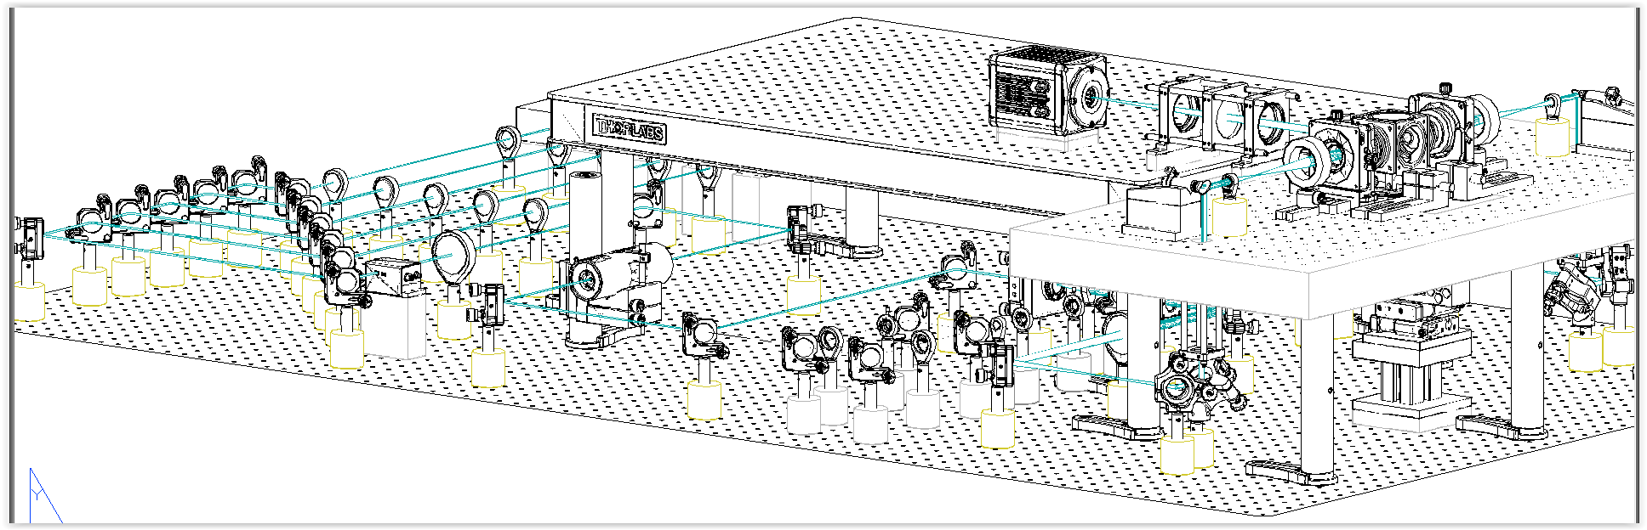
Outlook: improved clearing and microscopy
Specialized optics for clearing solutions
Double-sided illumination
Adaptive optical elements
Large-data management infrastructure
Focus on Microscopy 2015 – Göttingen, Germany, April 1st, 2015

Slide 18
Outlook: improved clearing and microscopy
Transverse section of an Arc-dVenus mouse brain processed with CLARITY and imaged with the new microscope.
Focus on Microscopy 2015 – Göttingen, Germany, April 1st, 2015

Slide 19
Conclusions
These preliminary results pave the way towards a quantitative mapping of neuronal activity across the whole brain with single-cell resolution. The high-throughput of the experimental pipeline will allow comparison of activity patterns between animals subjected to different stimuli, and between healthy and diseased mice.
Sample preparation with CLARITY guarantees better fluorescence preservation together with high transparency.
A new light sheet microscope suited for CLARITY is producing datasets of higher quality
Semantic deconvolution must be implemented in strongly parallel architectures to be capable of managing TB-sized datasets.
Non-rigid alignment of datasets to standard reference atlases (Allen, INCF) is needed to quantitatively compare different brains.
Focus on Microscopy 2015 – Göttingen, Germany, April 1st, 2015

Slide 20







Acknowledgements
LENS, Florence
Ludovico Silvestri
Irene Costantini
Dr. Leonardo Sacconi
Prof. Francesco Saverio Pavone
University of Florence
Marco Paciscopi
Prof. Paolo Frasconi
Harvard Medical School, Boston
Dr. Nikita Rudinskiy
Prof. Bradley T. Hyman
Funding:

Slide 21
Thank you for your attention!

Slide 22
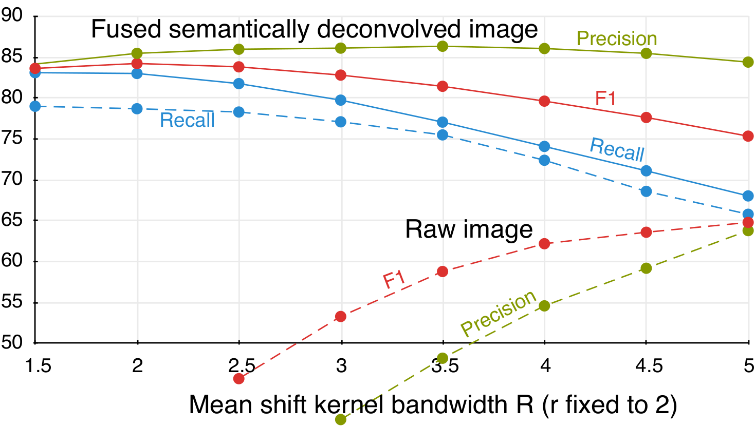
Automatic 3D cell localization
Raw images were acquired with a 4x objective to keep data size smaller (total ~ 40 Gvoxels). However, the reduced image quality leads to lower performances.
Focus on Microscopy 2015 – Göttingen, Germany, April 1st, 2015

